Slide 1
Data Management and Access Overview
2025-05-28

Slide 2
What comprises an ‘Observation?’
A set of 11 videos in two categories:
The science video set includes four pairs of two-minute videos in the science wavelength bands
The context video provides an RGB optical image for context and interpretation of the science data
Each observation is identified by an observation key (obskey):
YYYYMMDDUT<a-z>
Where a-z is a sequential index of the observations on that date
‘(Observing) Session’ is comprised of all observations on a given date
Purpose |  |  | Center Wavelength (nm) | Video Duration (s) | Center Time (s) | Sys. 2 CM (deg)
Continuum |  |  | 656 | 120 | -420 | -4.2
 |  |  | 632 | 120 | -300 | -3.0
 | CH4 |  | 620 | 120 | -180 | -1.8
 |  | NH3 | 647 | 120 | -60 | -0.6
 |  |  | 647 | 120 | 60 | 0.6
 |  |  | 620 | 120 | 180 | 1.8
 |  |  | 632 | 120 | 300 | 3.0
 |  |  | 656 | 120 | 420 | 4.2
(IR)GB Context |  |  | >685 | 60 | 510 | 5.1
 |  |  | 550 | 60 | 570 | 5.7
 |  |  | 450 | 60 | 630 | 6.3
A single observation with a “nested” sequence of science observations to maximize signal to noise and minimize rotational offsets in Jupiter’s central .

Slide 3
Organization Concept
All Jupiter Data
Collection 1
Collection 2
Collection N
Obskey 1
Obskey 2
Obskey 3
Obskey 4
Obskey 5
Obskey 6
Obskey 7
Obskey 8
Obskey 9
Obskey N
Collections are sets of observations (obskeys) specified by a start and end date and a descriptive string, e.g., ‘20250116-20250116 NEDF Study’
Tons of purposes with overlap in collections

Slide 4
Data Levels
Level 0 data (AVI):
Individual, single-filter videos (NxM pix, L frames)
Nested pairs of videos for science data
Raw – no calibration applied
Level 1a data (PNG):
Individual, single-filter images (NxM)
Calibrated (flat field)
Navigated (MaximDL & WinJUPOS)
Level 1b data (PNG):
Image triples (NxMx3)
Navigated
Derotated to a common CM and time
Brightness normalized channels
Level 2 data (FITS):
Ratio of in-band to continuum
Transmission calibration
Images and cylindrical maps
Level 3 data (FITS):
Retrieved environmental parameters
Images and cylindrical maps
620 nm
620 nm
620 nm
CH4 Triple
CH4 Transmission Map
Effective Cloud-top Map
656 nm
656 nm
656 nm
632 nm
632 nm
632 nm
647 nm
647 nm
647 nm
NH3 Triple
NH3 Transmission Map
NH3 Abundance Map
>685 nm
>685 nm
550 nm
550 nm
RGB Context Triple
RGB Context Map
450 nm
450 nm
Level 0 goes to deep storage after initial procession
Level 1a rarely retrieved except for assessing data problems
Level 1b accessed rarely, mainly for initial processing
Level 2 data are used to understand basic physics of atmosphere
Level 3 data are primary product used for research

Slide 5
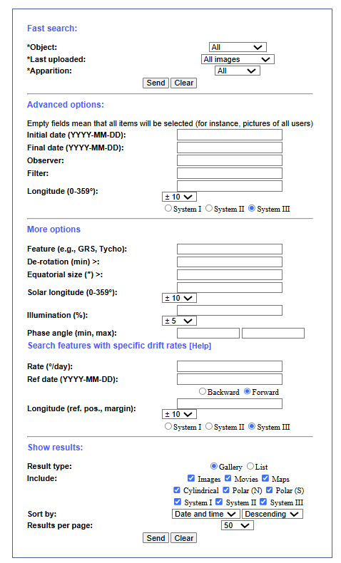
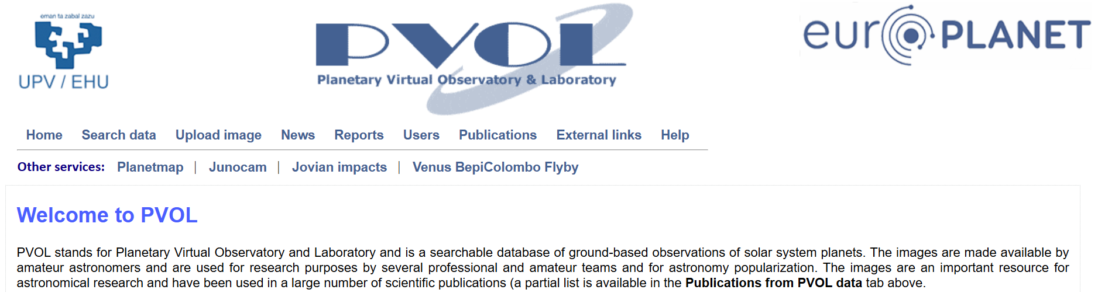
Data Access Example 1
Example 1 public data site http://pvol2.ehu.eus/pvol2/
Data file lists, image displays, search capability
Built on webservice

Slide 6
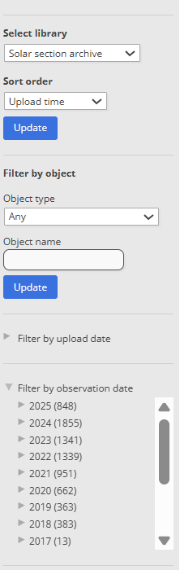

Data Access Example 2
Example 2 public data site https://britastro.org/observations/?library=42
Data file lists, image displays, search capability
Built on webservice

Slide 7

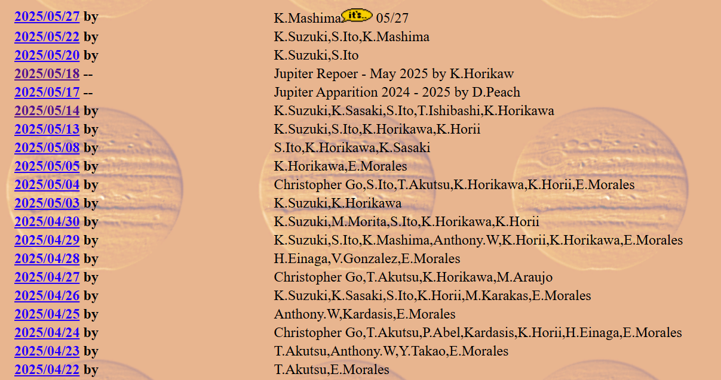
Data Access Example 3
Example 3 public data site https://alpo-j.sakura.ne.jp/Latest/Jupiter.htm
Simple index by date
Each date links to a page with Jupiter images posted
No search capability
Some additional sections for reports and details

